Slide 1
CUT Pitch Deck
Chenghao Wu

Slide 2
Table of contents
01
02
03
04
Problem vs. solution
Product
Market & competition
Business model & team

Slide 3

Introduction
Nowadays, e-commerce has paved every aspect of our life. Life got easier, but things get complicated.

Slide 4

Our company
W Group
W Group is a company dedicating to provide IT solutions for modern society’s pain points using data and AI technology. Our products are mainly focusing on e-commerce, finance and engineering industry. Today we will introduce one of our products ---- CUT.

Slide 5

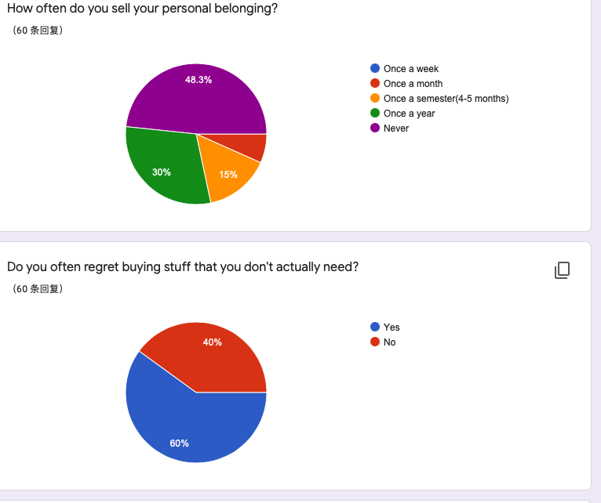
The problem
Many college students always purchase things they don’t need. Meanwhile, when moving out from their apartment, their pre-owned goods always are given away for free, which will result in their financial loss.

Slide 6
Them
Us
Although we can sell our pre-owned goods on Craiglist, E-bay, or Amazon, but it’s not the most effective way, sometimes it could be time-consuming and complicated. people need to wait for buyers, ship the items and waiting for their money.
Simply upload the pics and enter the price, we will find buyers for you quickly. Then you can give the item to your buyer personally or we deliver it for you. NO needs for shipping!

Slide 7

The solution
For college students who want to sell their pre-owned products or buy ones efficiently and make their life simple. CUT is a platform where they can sell or buy their goods regionally.
Unlike E-bay or Amazon, we mainly served for college students and people can sell/buy their products effectively, without the needs for shipping.

Slide 8
SWOT analysis
Strengths
Weaknesses
Opportunity
Threats
More friendly to college students, we may have the products they want.
Not for everyone, the user age demographic is mainly 19-30 years old.
We can have partnership with colleges or apartments.
Many big e-commerce platforms have existed.

Slide 9
— Danshari
“ Refuse to bring unnecessary new possessions into your life.“ “ Throw away existing clutter in your living space. “ “ Separate from a desire for material possessions. “

Slide 10
Product overview
Regional
Customized
Secure
We corporate with local students apartments and college departments.
We design the website, database, app, UI based on different university/apartments
Every transaction will be protected. The delivery will be safe and effective.

Slide 11
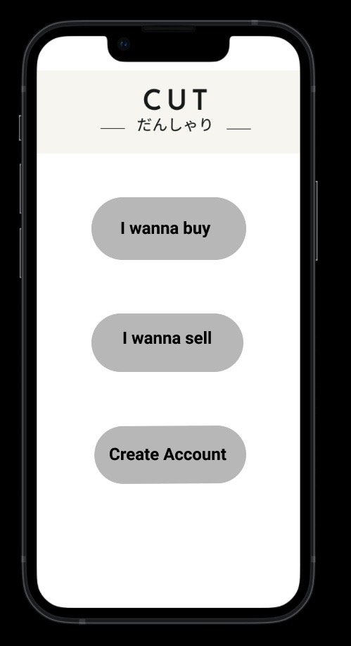
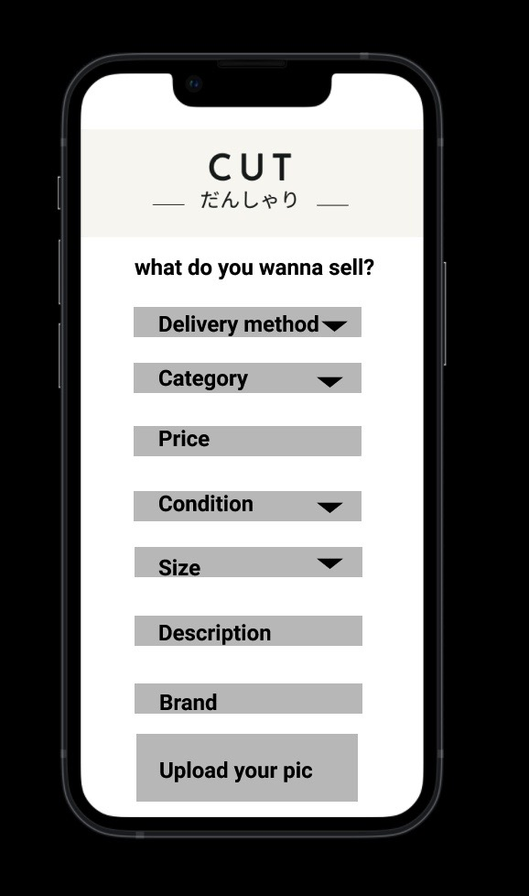
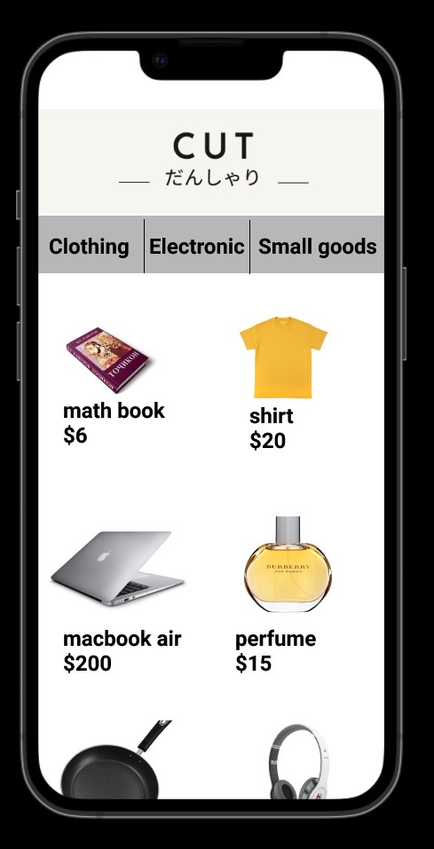
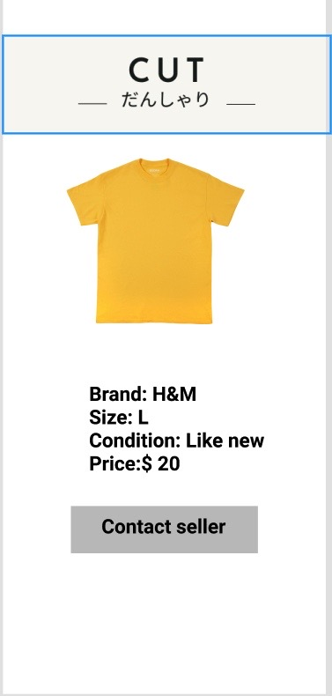
Product Prototype

Slide 12
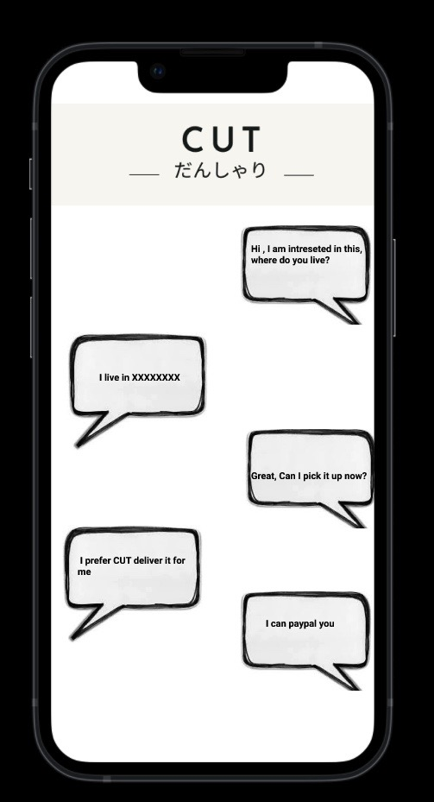
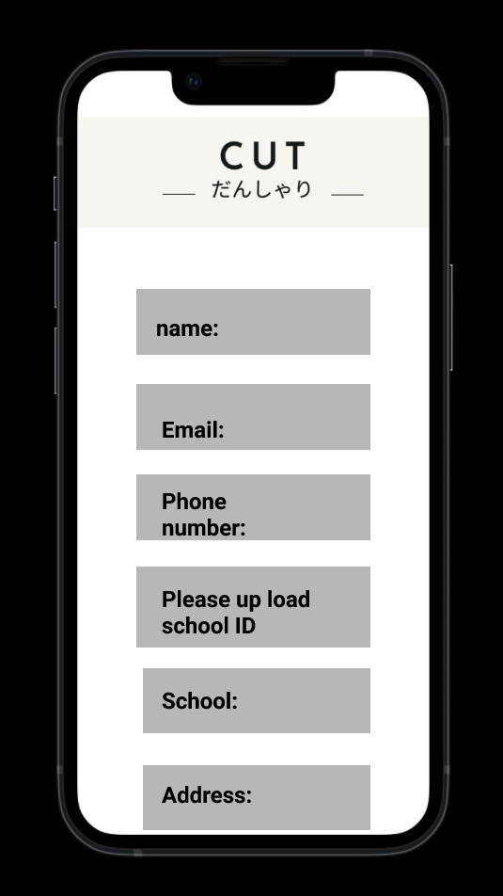
Product Prototype

Slide 13
Our plans
Individual | School | Apartment
This is for individual student, you only have the limited features. | This is for school department or any educational organization, we customize the app UI for you. | This is for local apartment. We can customize the UI for you.
$$5/Mo | $25/Mo | $35/Mo

Slide 14

Our traction
16.7%
Will sell their goods once a semester
40%
Having the experience regret buying a product.
50.0%
Will Sell their personal belongings

Slide 15
03
Market & competition
You could enter a subtitle here if you need it

Slide 16
Market size
School
Apartments
Students
We can sell the product to

Slide 17
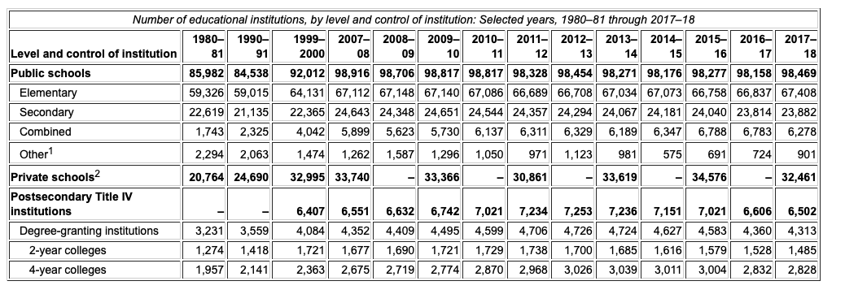
130930
Schools in the U.S

Slide 18
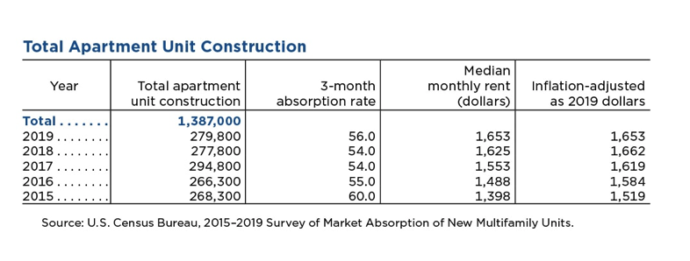
1387000
Apartments in the U.S

Slide 19
Our target
Annual benefits
Age & gender
$45.00
Workspace tools
Average spend per customer
20-25
26-55
56+

Slide 20

Our competitors
Amazon
Amazon is one of the biggest e-commerce platform, we could use switch back strategy, value chain to disruptive.
E-bay
Amazon is one of the biggest e-commerce platform, we could use disruptive strategy

Slide 21
Business model
Marketing
Customer Acquisition
Assessment
Technology
Digital marketing using Instagram and Facebook
Both have 2B and 2C product. Revenue projection will be $37740 in 2022 per region.
Patent for our app, brand, UI and database
Generate link every time so user can list item to other platform. The net CLV will be 170 per month.

Slide 22
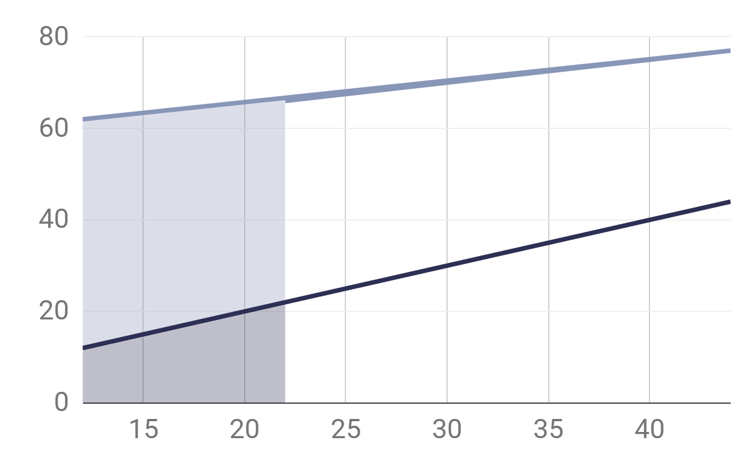
Our investment
0
$10000
2021 Year
2020 Year
Please invest us

Slide 23

Our team
Chenghao Wu
M.S in Data Science
M.S in Business Analytics
Tony Stark
AKA Iron Man

Slide 24
Thanks
Do you have any questions?
cwu137@syr.edu +1 315 289 0209 chenghaowu.com

